Slide 1
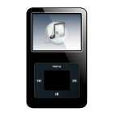
2 chronicles 1:1 – 4:22
A CD of this message will be available (free of charge immediately following today's message
This message will be available via podcast later this week at calvaryokc.com

Slide 2
2 chronicles 1:1 – 4:22
1 Samuel
2 Samuel
1Chronicles
1 Kings
2 Kings
2 Chronicles

Slide 3
2 chronicles 1:1 – 4:22
Deut. 17:18-20 ~ ¹⁸ Also it shall be, when he sits on the throne of his kingdom, that he shall write for himself a copy of this law in a book, from the one before the priests, the Levites. ¹⁹ And it shall be with him, and he shall read it all the days of his life, that he may learn to fear the LORD his God and be careful to observe all the words of this law and these statutes, ²⁰ that his heart may not be lifted above his brethren, that he may not turn aside from the commandment to the right hand or to the left, and that he may prolong his days in his kingdom, he and his children in the midst of Israel.
Deut. 17:14-17 ~ ¹⁴ When you come to the land which the LORD your God is giving you, and possess it and dwell in it, and say, ‘I will set a king over me like all the nations that are around me,’ ¹⁵ you shall surely set a king over you whom the LORD your God chooses; one from among your brethren you shall set as king over you; you may not set a foreigner over you, who is not your brother. ¹⁶ But he shall not multiply horses for himself, nor cause the people to return to Egypt to multiply horses, for the LORD has said to you, ‘You shall not return that way again.’ ¹⁷ Neither shall he multiply wives for himself, lest his heart turn away; nor shall he greatly multiply silver and gold for himself.

Slide 4
2 chronicles 1:1 – 4:22
Selected ~ KJV, told out

Slide 5
2 chronicles 1:1 – 4:22
Kor < 6 bushels
Bath ~ 5 – 8 gallons

Slide 6
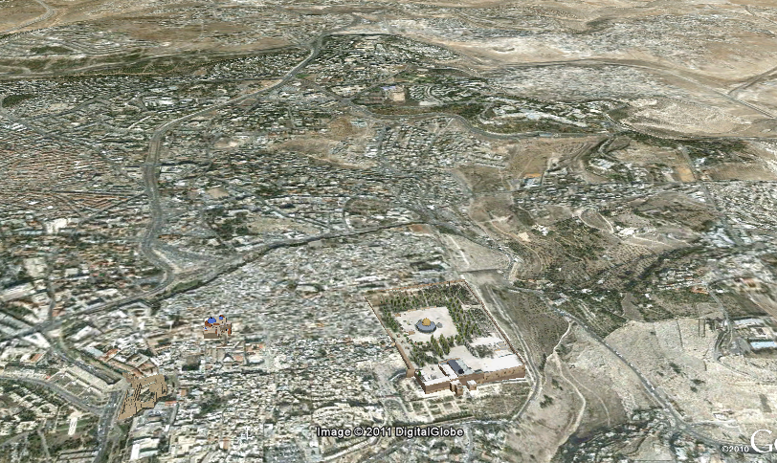
2 chronicles 1:1 – 4:22
Golgotha
Temple Mount
Mt. Moriah
Kidron Valley
Tyropean Valley

Slide 7
2 chronicles 1:1 – 4:22
50'
20 cu
60 cu
94'

Slide 8
2 chronicles 1:1 – 4:22
Inner sanctuary ~ KJV, oracle

Slide 9
2 chronicles 1:1 – 4:22
Jachin ~ Established
Boaz ~ Strengthened

Slide 10
2 chronicles 1:1 – 4:22
The Bronze Altar
15'
30'

Slide 11
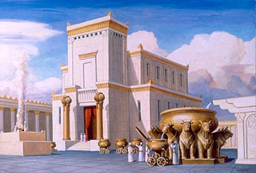
2 chronicles 1:1 – 4:22

Slide 12
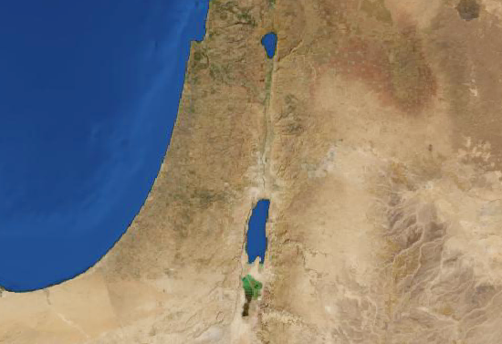
2 chronicles 1:1 – 4:22
Succoth
Jerusalem

